Slide 1
Link Prediction in Graph Streams
-Murali Krishna Pusala -Sai Akash Kuthuru(sxk3190)

Slide 2
Topics
Introduction
Why Apache Flink
Sketching Algorithms
Similarity Measures
Preferential Attachment
Jaccard Coefficient
Common Neighbours
Adamic Adar
Conclusion

Slide 3
Introduction
Large data in the form of graphs referred as graph streams
We cannot employ batch processing
Edges are received and updated sequentially.
Sketching algorithms are employed to update the graph in real time.
Apache Flink along with Gelly streaming API is considered.

Slide 4
Why Apache Flink with Gelly streaming?
Apache Flink framework supports batch and stream processing along with high-level API when compared to Apache Flink.
Flink is optimized for cyclic or iterative processes by using iterative transformations on collections.
Fault tolerance in flink effects about 25% of throughput whereas Apache Spark with 50% and Apache Storm with 70%

Slide 5
Sketching Algorithms
Sketching algorithms are employed on data streams which have finite memory.
Sketching algorithms in graph data utilize (random) linear projection to compress a graph in a way that relevant properties of the graph can be estimated with high accuracy and confidence.
Process input data in one pass.

Slide 6
Similarity Measures
Similarity measures give a numeric measure of how alike two data objects.
In graph stream, similarity measures provide how alike are to nodes in the graph.
In this project, we calculated following similarity measures.
Preferential Attachment
Jaccard Coefficient
Common Neighbors
Adamic Adar

Slide 7
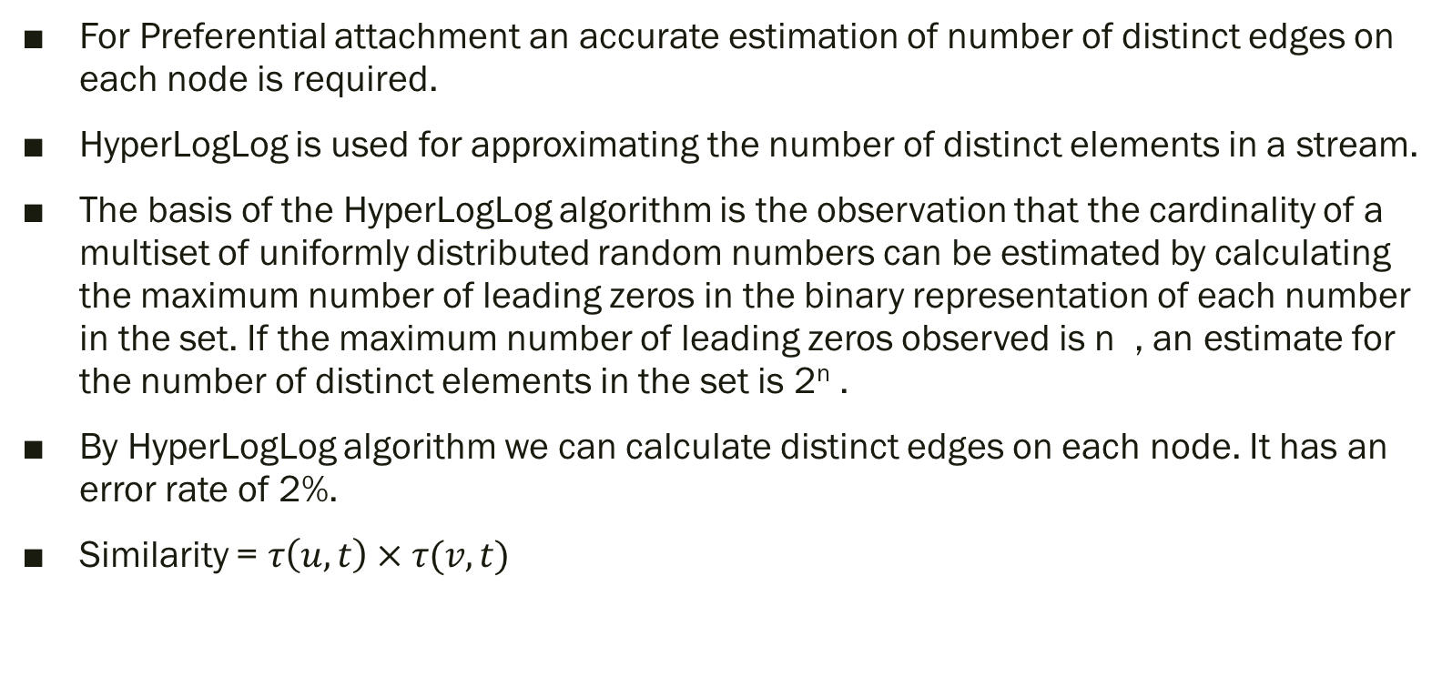
Preferential Attachment
For Preferential attachment an accurate estimation of number of distinct edges on each node is required.
HyperLogLog is used for approximating the number of distinct elements in a stream.
The basis of the HyperLogLog algorithm is the observation that the cardinality of a multiset of uniformly distributed random numbers can be estimated by calculating the maximum number of leading zeros in the binary representation of each number in the set. If the maximum number of leading zeros observed is n , an estimate for the number of distinct elements in the set is 2^{n} .
By HyperLogLog algorithm we can calculate distinct edges on each node. It has an error rate of 2%.
Similarity = $τ\left(u,t\right) × τ(v,t)$

Slide 8
Jaccard Coefficient
It is used to measure similarity between two vertices and is defined as ratio of number of common neighbors to number of total neighbors for two vertices.
We design MinHash based skech to obtain jaccard coefficient.
For an edge(u,v) we hash v id using K number of hash functions with respect to u and vice versa.
We maintain data structure to store nodes for which we obtain minimum hash values for every node employing K hash functions.

Slide 9
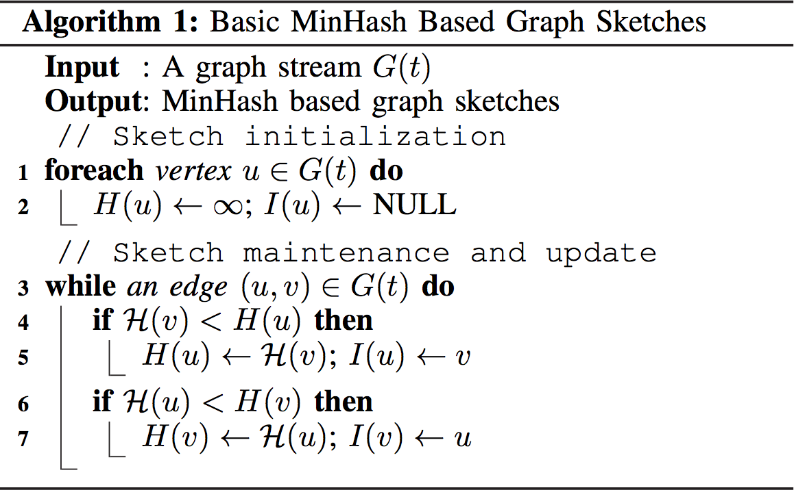
Sketching Algorithm for Jaccard Coefficient

Slide 10
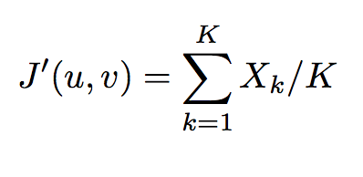
Calculating Jaccard coeffcient
Consider an nodes u and v for which we need to calculate jaccard Coefficient.
As we maintain K hash functions we get K min-hash values. We use following formula to get Jaccard Coefficient.
Where X_{k} value where min-hash value is same for both u and v.
K indicating number of hash functions considered.

Slide 11
Common Neighbors
We maintain L sized reservoir for every node in graph G(t)
We consider a Hash function which produces hash values between 0 to 1 using their corresponding vertex indentifiers.
We maintain Lower eta and Higher Eta for every node.
For an incoming edge(u,v) we maintain reservoirs S(u) and S(V).
We add v in S(u) and u in S(v). We continue this process till reservoir is full and update Lower eta and Higher eta values.
If we get a new node for u, we check whether hash value of new node is less than miniumum value priority node. If it satisfies we replace new node with maximum value node from the reservoir

Slide 12
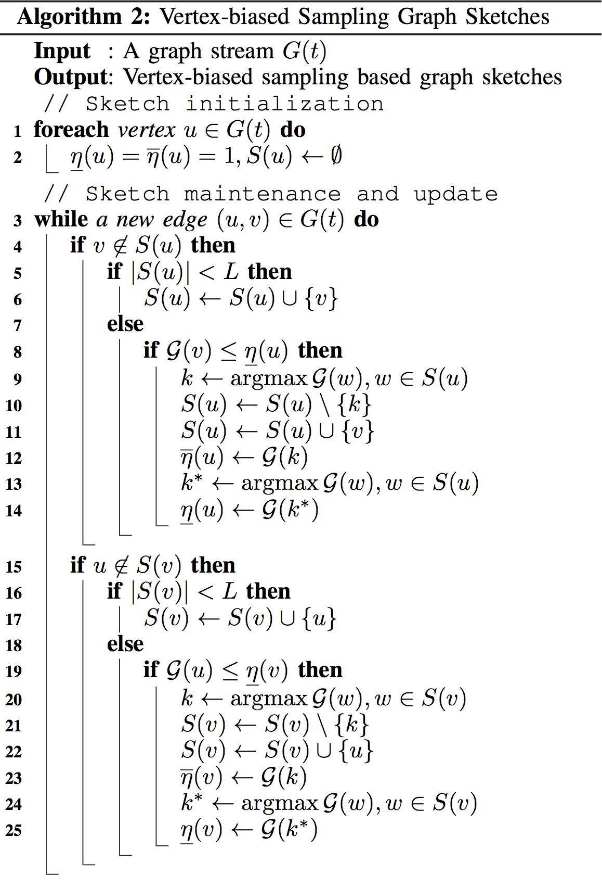
Sketching Algorithm for Common Neighbor’s

Slide 13
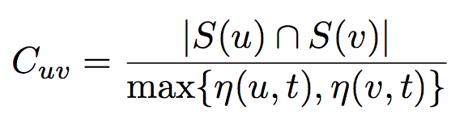

Calculating Common Neighbor’s
Consider nodes u and v for which we need to calculate number of Common Neighbor’s.

Slide 14
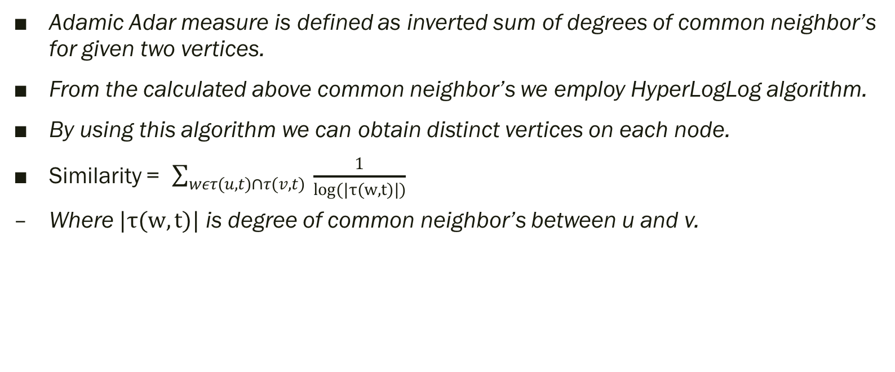
Adamic Adar
Adamic Adar measure is defined as inverted sum of degrees of common neighbor’s for given two vertices.
From the calculated above common neighbor’s we employ HyperLogLog algorithm.
By using this algorithm we can obtain distinct vertices on each node.
Similarity = $\sum_{wετ(u,t)∩τ(v,t)}{ \frac{1}{log(|τ(w,t)|)}}$
Where $|τ(w,t)|$ is degree of common neighbor’s between u and v.

Slide 15
Technical Specifications
Big Data Tools: Hadoop, Flink, Gelly.
Programing Language: Java.
Programing Environment: Linux.

Slide 16
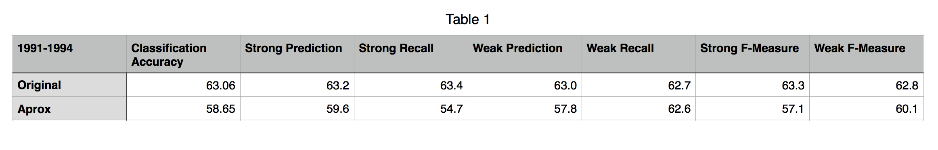
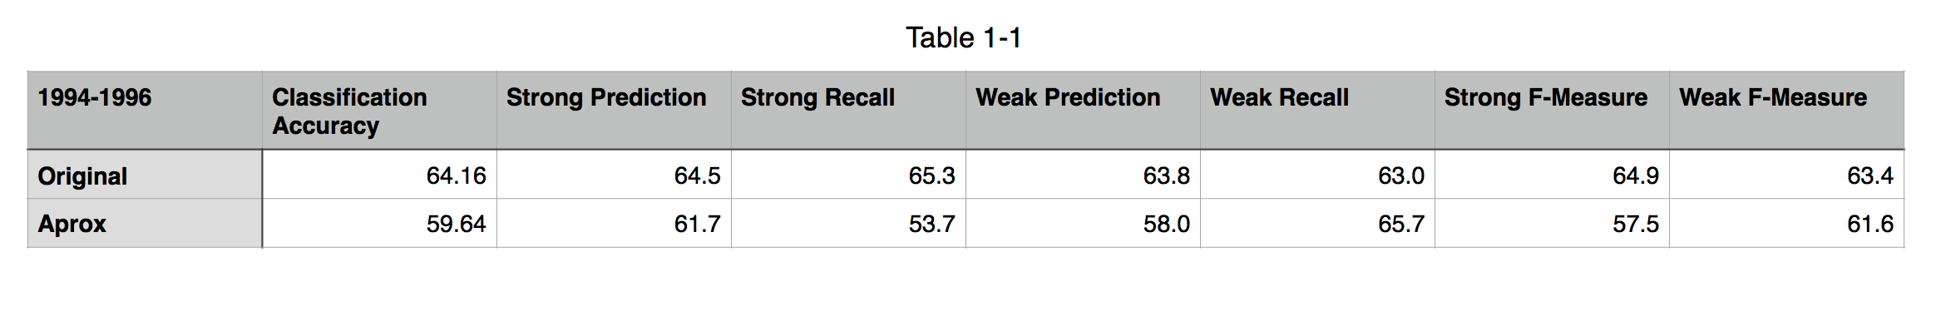
Conclusion
Year 1991-1994
Year 1994-1996

Slide 17
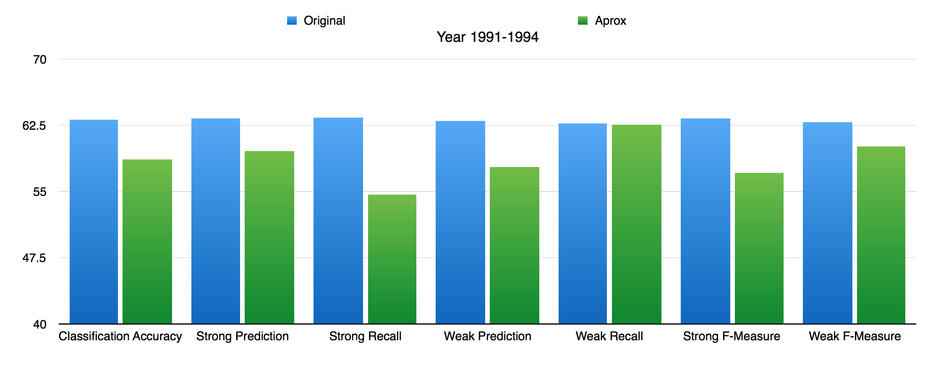
Conclusion continued
Year 1991-1994

Slide 18
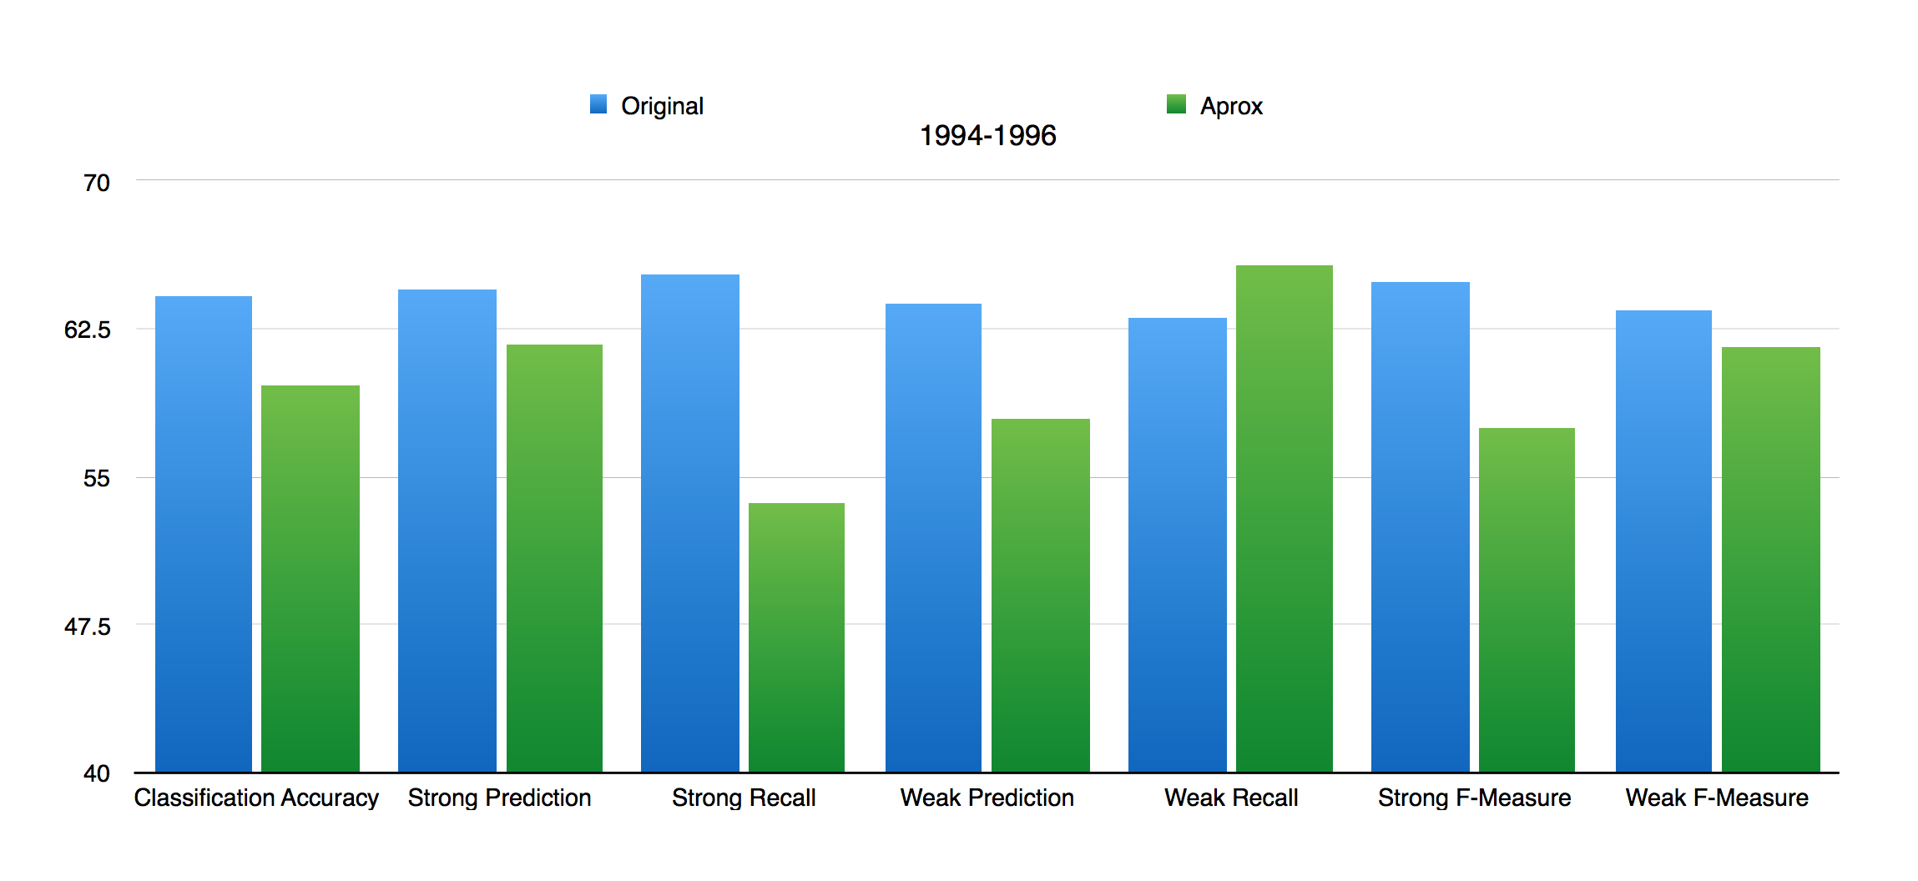
Conclusion
Year 1994-1996

